Slide 1
IT Summer Intern Presentation
July 31, 2018
Christopher Gu and Tanner Marino

Slide 2

Christopher Gu
Missouri University of Science & Technology
Major: Computer Science
Minor: Bioinformatics
Graduation: May 2020
From Greater St. Louis

Slide 3

Tanner Marino
University of Nebraska-Lincoln
Major: Computer Science
Graduation: May 2019

Slide 4
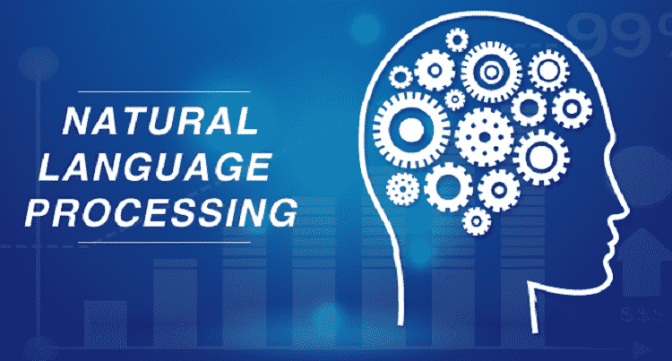
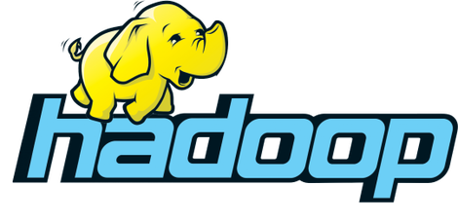
Problem Statement
Notes:
The problem statement we were given was that we were to work with Natural Language Processing and graphics to put a conversational front-end on data.
The data we were working with specifically was Hadoop, which is a framework for storing data and running applications on clusters of hardware.
Build a context aware natural language interface to Hadoop
Use NLP to answer user questions
Build a knowledge graph of Hadoop ecosystem
Build a metadata repository for Hadoop ecosystem

Slide 5
Choosing the right tool
Notes:
The first actual working week of our internship was used to research different tools to aid us in our final product.

Slide 6


What We Wanted
Robust Artificial Intelligence & Machine Learning
Adequate Documentation
Low Cost
Ability to Integrate
Handling of UP Knowledge

Slide 7
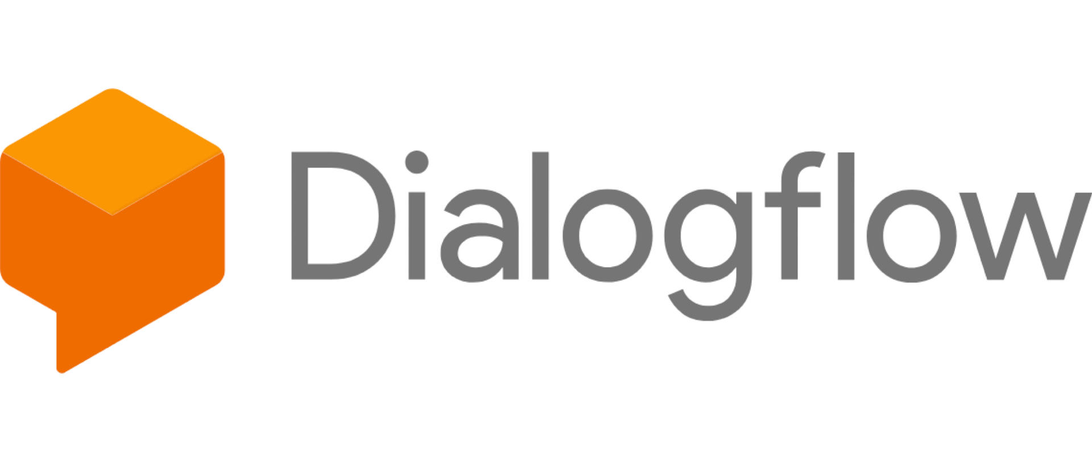
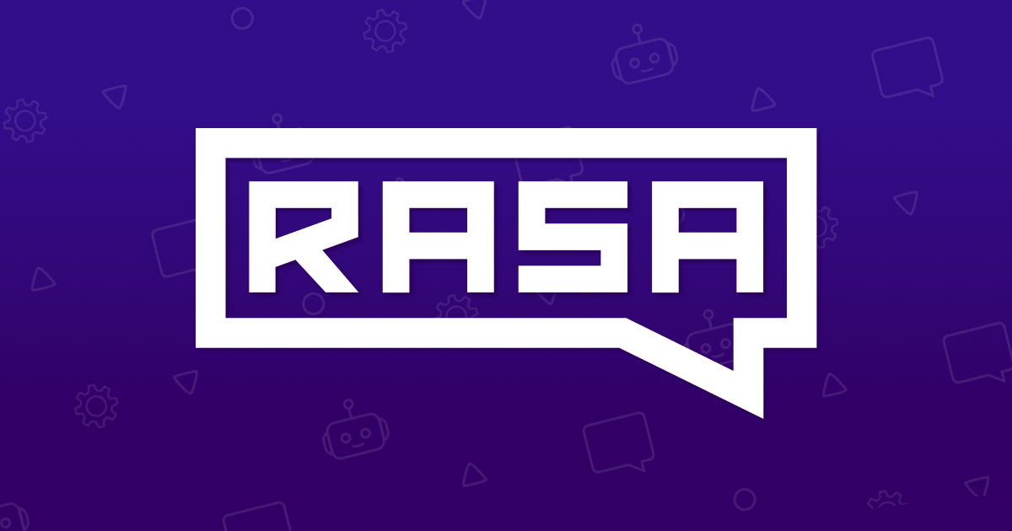


4 Major Tools
Amazon Lex
Microsoft Luis
Notes:
Dialogflow is a Google-owned developer of human-computer interaction technologies and is best known for creating the Google Assistant. It provides a nice and easy-to-use user interface and has top-notch artificial intelligence and machine learning already built in. However, the backend technologies are hidden from the user, the enterprise tiers are not free, and data is required to be either uploaded or accessed via https.
When researching Amazon Lex and Microsoft Luis, we found that they were both very similar to Dialogflow.
Rasa, however, was a different story.

Slide 8
Rasa
Notes:
Rasa isn’t a fully built user interface product like Dialogflow, Lex, and Luis. It’s a tool that intends to be the HTML of Chatbot AI; they want to become the standard.

Slide 9

Rasa
Benefits
Open Source
Fully Customizable
Machine Learning
Deep Learning
Notes:
Latest machine learning research integrated
Handles contextual dialogues with deep learning

Slide 10
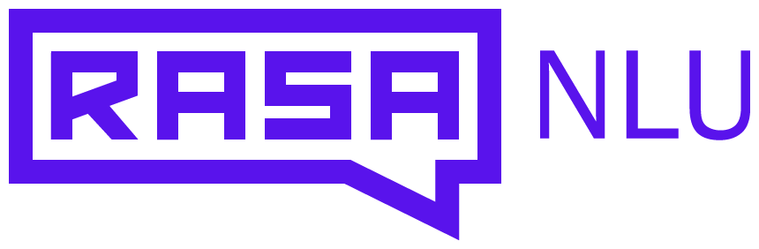
Rasa
Introduction
CORE
Notes:
Rasa NLU serves as the backend tool for understanding what is being said in text and identifying the intention and entities within the message
Rasa Core serves as the contextual component that allows users to converse with the bot and providing the bot with the context of the conversation

Slide 11
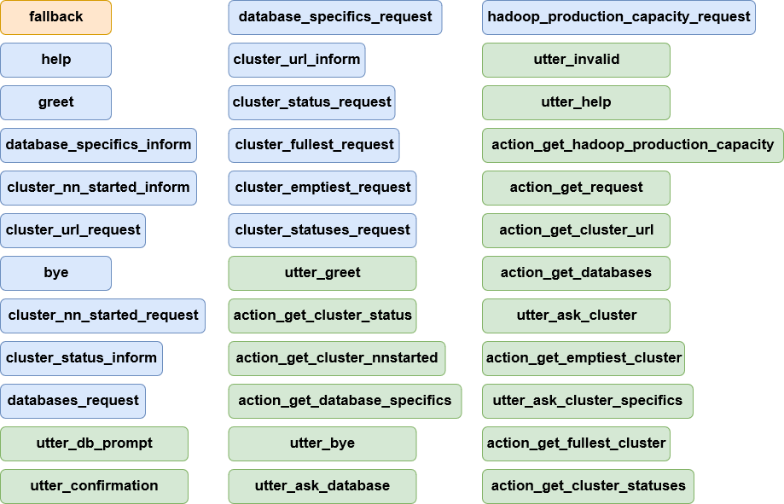
Conversation Diagram
Green: actions Blue: messages Orange: fallback
Notes:
The green boxes represent all the different kinds of actions that a user can do.
The blue boxes represent all the intents that are called on by actions to return a response.
The orange box represents the fallback, which returns a default response when a user types an action that doesn’t exist.

Slide 12
Demo

Slide 13
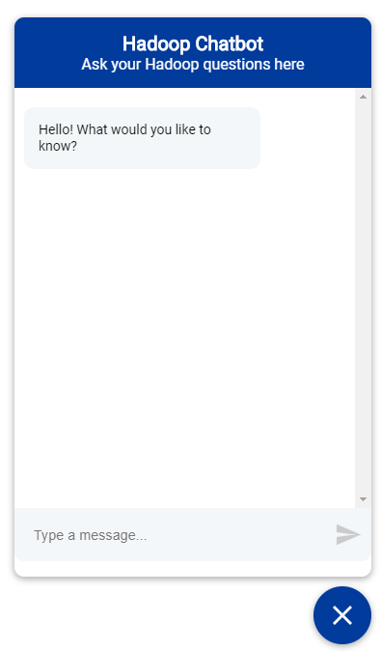
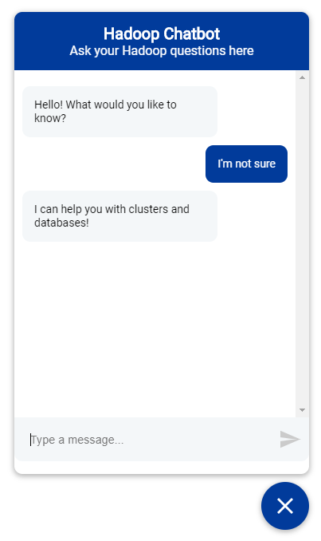
Introduction

Slide 14
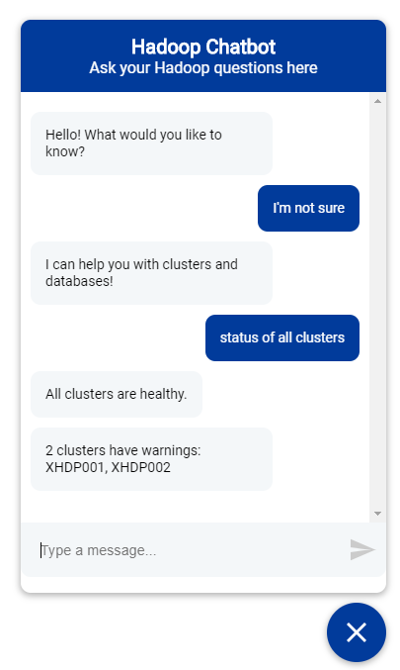
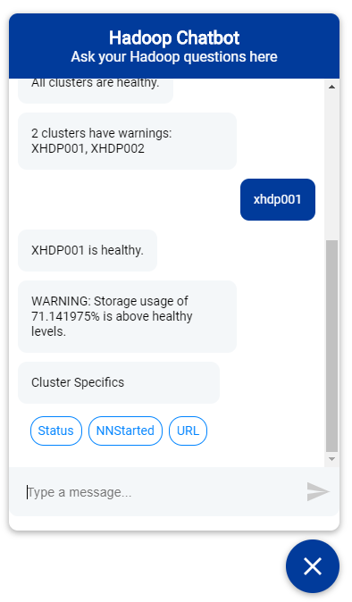
Cluster Info

Slide 15
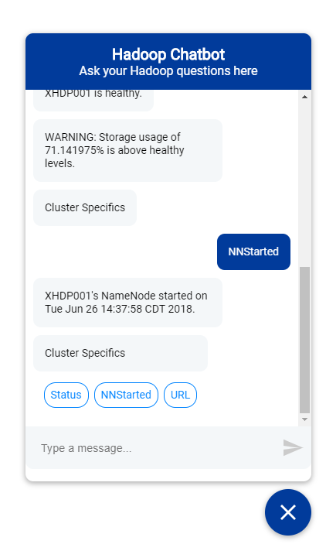
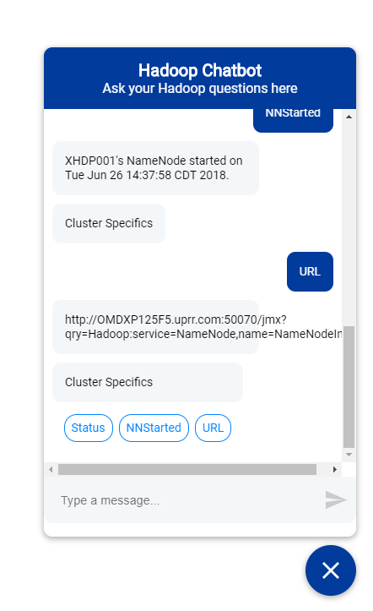
Cluster Info

Slide 16
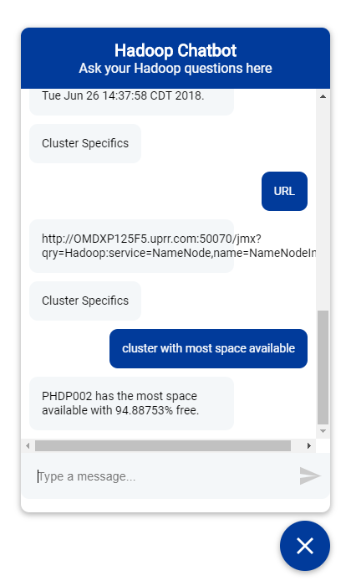
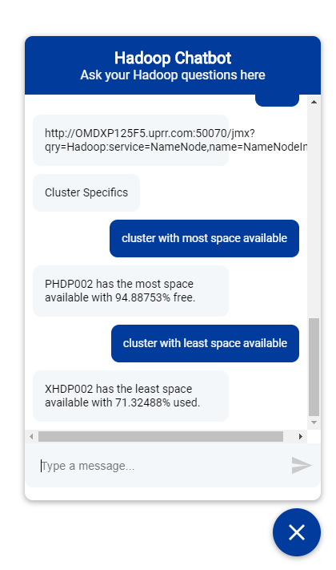
Cluster Info

Slide 17
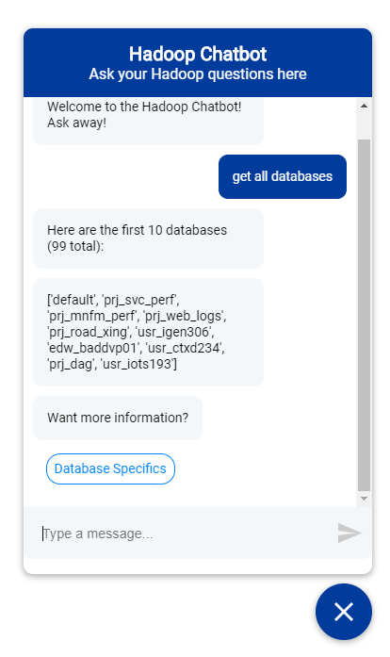
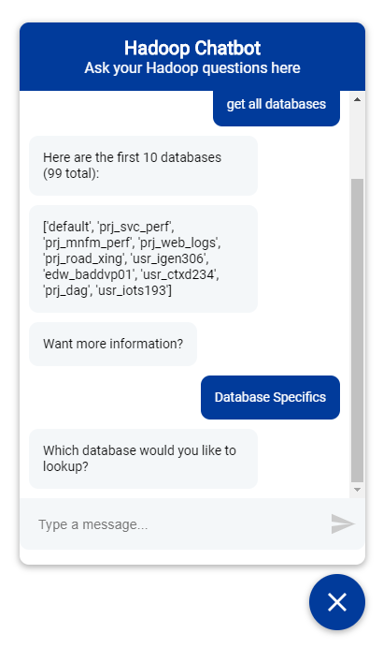
Database Info

Slide 18
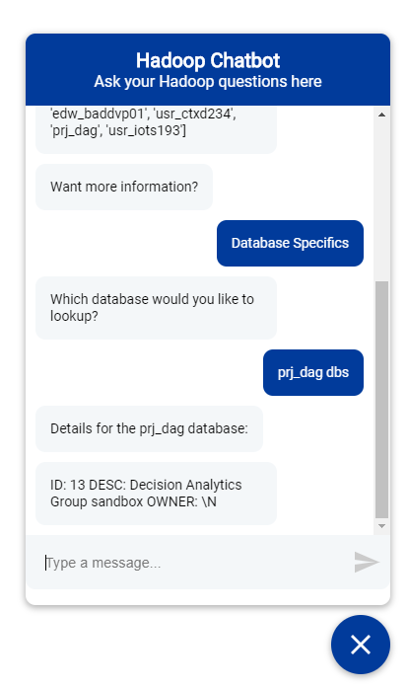
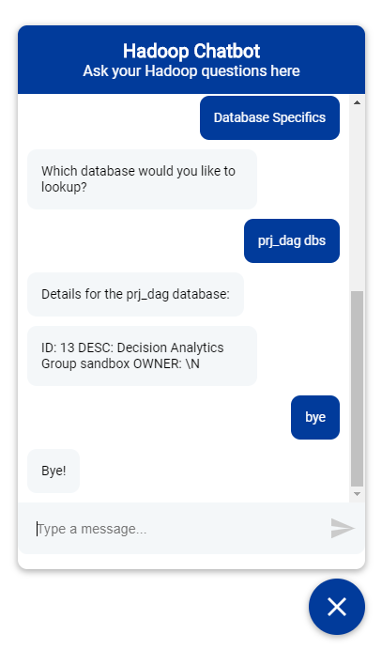
Database Info

Slide 19
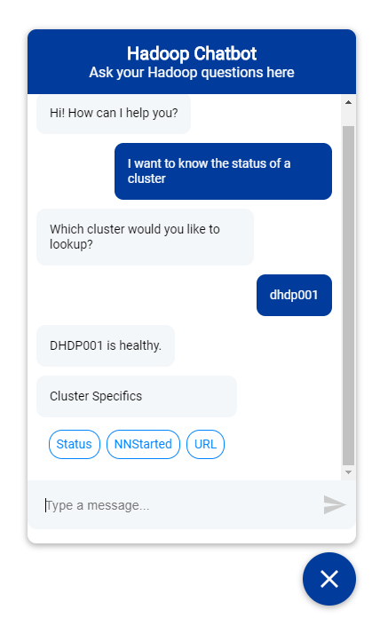
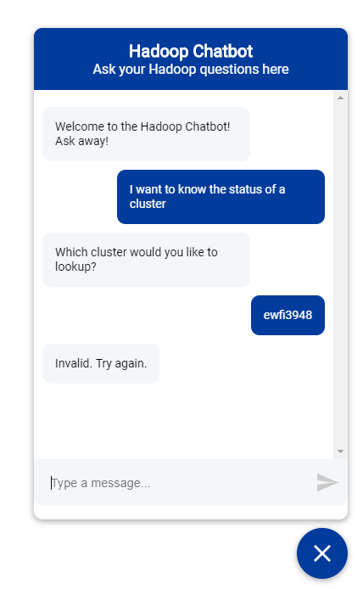
Error Checking

Slide 20
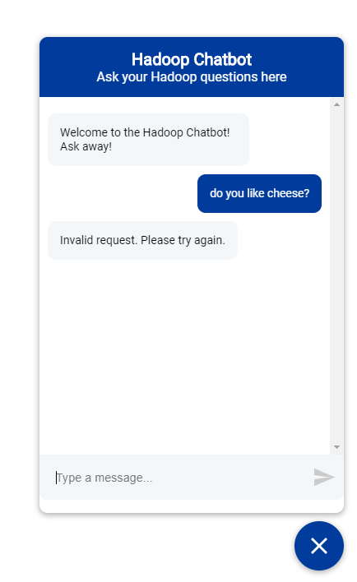
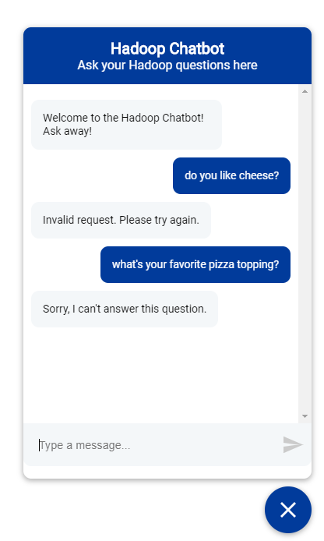
Error Checking

Slide 21
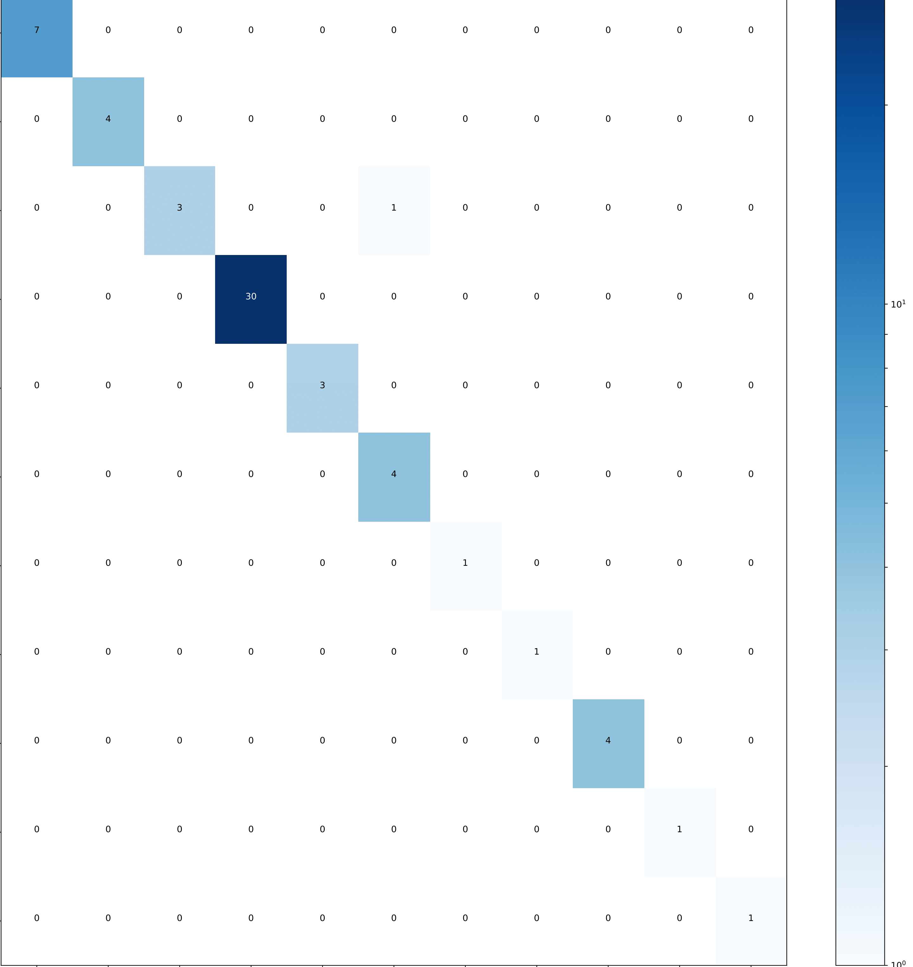
Progress
Action Confusion Matrix
Intent evaluation results:
Training Accuracy: 0.991
Training Precision: 0.992
Test Accuracy: 0.911
Test Precision: 0.872
Entity evaluation results
Training Accuracy: 0.992
Training Precision: 0.992
Test Accuracy: 0.986
Test Precision: 0.986
True Labels
Predicted Labels

Slide 22
Experience
Challenges Experienced
Validating user input
Constructing stories (user paths)
Understanding similar but different UP terms
Experience Gained
Hadoop Architecture
UP Architecture Knowledge
Using tools to train models
Transforming data

Slide 23
Conversations
Enterprise Architecture Council (EAC)
Offered an alternative to currently used NLP tools:
Eloquent Labs
Stanford NLP
Rasa
Communicated with the Rasa Team in Berlin to discuss their tools:
Features of their open source tools
Features of their paid-for interfaces
Pros and cons
Help with debugging
Miscellaneous questions
Notes:
We were given the chance to present in front of the EAC, Enterprise Architecture Council, and were able to offer a promising alternative to tools already being used by UP. These include Eloquent Labs, which is part of the Plug and Play Incubator program, and Stanford’s NLP software. As a result of the meeting, we realized that our intern research project might affect how UP uses Chabot technologies in the future.

Slide 24
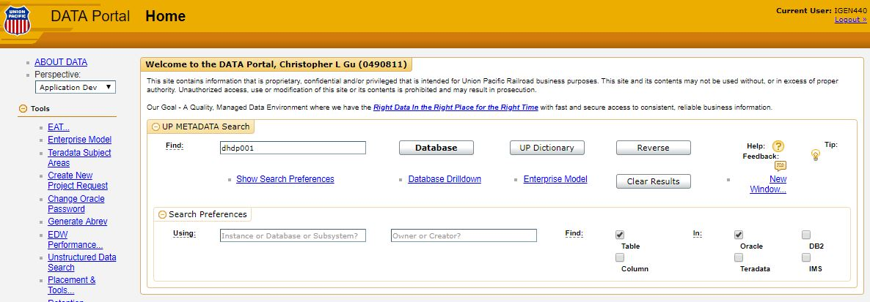
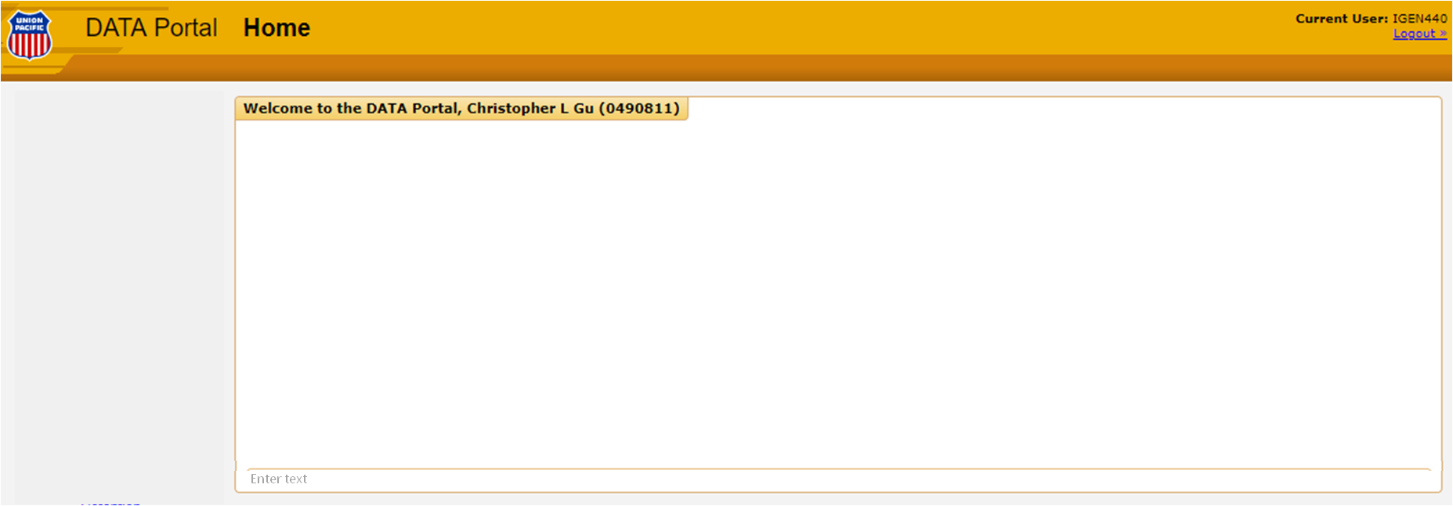
Moving Forward
Replace Data Portal with Chabot
Notes:
In conclusion, our intern project of interfacing with Hadoop was basically a trial run of Rasa. We wanted to see how it worked and whether it can be applicable to larger projects. If deemed successful, the next step would be to continue the conversation with the team at Rasa and to create a Chatbot for UP’s data portal!

Slide 25

QUESTIONS?

